Slide 1
CHAPTER 4
PROBABILITY

Slide 2
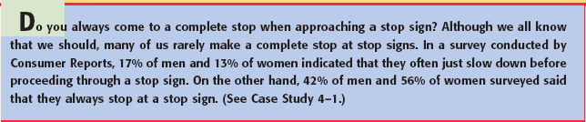
Opening Example

Slide 3
EXPERIMENT, OUTCOMES, AND SAMPLE SPACE
Definition
An experiment is a process that, when performed, results in one and only one of many observations. These observations are called that outcomes of the experiment.
The collection of all outcomes for an experiment is called a sample space.

Slide 4
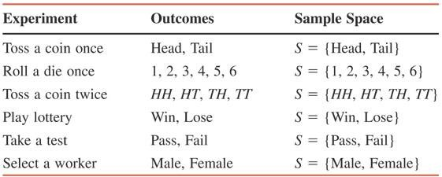
Table 4.1 Examples of Experiments, Outcomes, and Sample Spaces

Slide 5
Example 4-1
Draw the Venn and tree diagrams for the experiment of tossing a coin once.

Slide 6
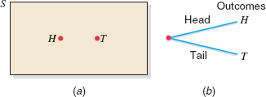
Figure 4.1 (a) Venn Diagram and (b) tree diagram for one toss of a coin.

Slide 7
Example 4-2
Draw the Venn and tree diagrams for the experiment of tossing a coin twice.

Slide 8
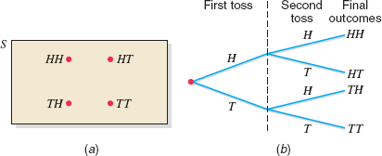
Figure 4.2 (a) Venn diagram and (b) tree diagram for two tosses of a coin.

Slide 9
Example 4-3
Suppose we randomly select two workers from a company and observe whether the worker selected each time is a man or a woman. Write all the outcomes for this experiment. Draw the Venn and tree diagrams for this experiment.

Slide 10
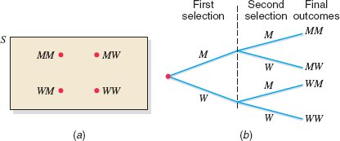
Figure 4.3 (a) Venn diagram and (b) tree diagram for selecting two workers.

Slide 11
Simple and Compound Events
Definition
An event is a collection of one or more of the outcomes of an experiment.

Slide 12
Simple and Compound Events
Definition
An event that includes one and only one of the (final) outcomes for an experiment is called a simple event and is denoted by E_{i}.

Slide 13
Example 4-4
Reconsider Example 4-3 on selecting two workers from a company and observing whether the worker selected each time is a man or a woman. Each of the final four outcomes (MM, MW, WM, and WW) for this experiment is a simple event. These four events can be denoted by E₁, E₂, E₃, and E₄, respectively. Thus,
E₁ = (MM), E₂ = (MW), E₃ = (WM), and E₄ = (WW)

Slide 14
Simple and Compound Events
Definition
A compound event is a collection of more than one outcome for an experiment.

Slide 15
Example 4-5
Reconsider Example 4-3 on selecting two workers from a company and observing whether the worker selected each time is a man or a woman. Let A be the event that at most one man is selected. Event A will occur if either no man or one man is selected. Hence, the event A is given by
A = {MW, WM, WW}
Because event A contains more than one outcome, it is a compound event. The Venn diagram in Figure
4.4 gives a graphic presentation of compound event
A.

Slide 16
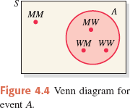
Figure 4.4 Venn diagram for event A.

Slide 17
Example 4-6
In a group of a people, some are in favor of genetic engineering and others are against it. Two persons are selected at random from this group and asked whether they are in favor of or against genetic engineering. How many distinct outcomes are possible? Draw a Venn diagram and a tree diagram for this experiment. List all the outcomes included in each of the following events and mention whether they are simple or compound events.
Both persons are in favor of the genetic engineering.
At most one person is against genetic engineering.
Exactly one person is in favor of genetic engineering.

Slide 18
Example 4-6: Solution
Let
F = a person is in favor of genetic engineering
A = a person is against genetic engineering
FF = both persons are in favor of genetic engineering
FA = the first person is in favor and the second is against
AF = the first is against and the second is in favor
AA = both persons are against genetic engineering

Slide 19
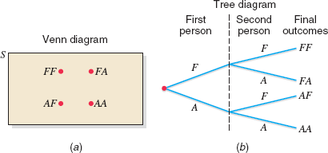
Figure 4.5 Venn and tree diagrams.

Slide 20
Example 4-6: Solution
Both persons are in favor of genetic engineering
= { FF }
Because this event includes only one of the final four outcomes, it is a simple event.
At most one person is against genetic engineering = { FF, FA, AF }
Because this event includes more than one outcome, it is a compound event.
Exactly one person is in favor of genetic engineering = { FA, AF }
It is a compound event.

Slide 21
CALCULATING PROBABLITY
Definition
Probability is a numerical measure of the likelihood that a specific event will occur.

Slide 22


Two Properties of Probability
The probability of an event always lies in the range 0 to 1.
The sum of the probabilities of all simple events (or final outcomes) for an experiment, denoted by ΣP(E_{i}), is always 1.

Slide 23
Three Conceptual Approaches to Probability
Classical Probability
Definition
Two or more outcomes (or events) that have the same probability of occurrence are said to be equally likely outcomes (or events).

Slide 24
Classical Probability
Classical Probability Rule to Find Probability
1
P(E ) =
i
Total number of outcomesfor theexperiment
Number of outcomesfavorable to A
P( A) =
Total number of outcomesfor theexperiment

Slide 25
Example 4-7
Find the probability of obtaining a head and the probability of obtaining a tail for one toss of a coin.

Slide 26
Example 4-7: Solution
1
P(head) =
= ¹ = .50
Total number of outcomes 2
Similarly,
P(tail) = ¹ = .50
2

Slide 27
Example 4-8
Find the probability of obtaining an even number in one roll of a die.

Slide 28
Example 4-8: Solution
A = {2, 4, 6}. If any one of these three numbers is obtained, event A is said to occur. Hence,
_{P(head) =} Number of outcomesincluded in A ₌ 3 _{= .50} Total number of outcomes 6

Slide 29
Example 4-9
In a group of 500 women, 120 have played golf at least once. Suppose one of these 500 women is randomly selected. What is the probability that she has played golf at least once?

Slide 30
Example 4-9: Solution
One hundred twenty of these 500 outcomes are included in the event that the selected woman has played golf at least once. Hence,
P(selected woman has played golf at least once) = ¹²⁰ = .24
500

Slide 31
Three Conceptual Approaches to Probability
Relative Frequency Concept of Probability
Using Relative Frequency as an Approximation of Probability
If an experiment is repeated n times and an event A is observed f times, then, according to the relative frequency concept of probability,
P( A) = ^{f}
n

Slide 32
Example 4-10
Ten of the 500 randomly selected cars manufactured at a certain auto factory are found to be lemons. Assuming that the lemons are manufactured randomly, what is the probability that the next car manufactured at this auto factory is a lemon?

Slide 33
Example 4-10: Solution
Let n denotes the total number of cars in the sample and f the number of lemons in n. Then,
n = 500 and f = 10
Using the relative frequency concept of probability, we obtain
P(next car is a lemon) = ^{f} = ¹⁰ = .02
n 500

Slide 34
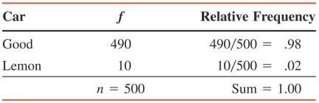
Table 4.2 Frequency and Relative Frequency Distributions for the Sample of Cars

Slide 35
Law of Large Numbers
Definition
Law of Large Numbers If an experiment is repeated again and again, the probability of an event obtained from the relative frequency approaches the actual or theoretical probability.

Slide 36
Three Conceptual Approaches to Probability
Subjective Probability
Definition
Subjective probability is the probability assigned to an event based on subjective judgment, experience, information and belief.

Slide 37

COUNTING RULE
Counting Rule to Find Total Outcomes
If an experiment consists of three steps and if the first step can result in m outcomes, the second step in n outcomes, and the third in k outcomes, then
Total outcomes for the experiment = m · n · k

Slide 38
Example 4-12
Suppose we toss a coin three times. This experiment has three steps: the first toss, the second toss and the third toss. Each step has two outcomes: a head and a tail. Thus,
Total outcomes for three tosses of a coin = 2 x 2 x 2 = 8
The eight outcomes for this experiment are
HHH, HHT, HTH, HTT, THH, THT, TTH, and TTT

Slide 39
Example 4-13
A prospective car buyer can choose between a fixed and a variable interest rate and can also choose a payment period of 36 months, 48 months, or 60 months. How many total outcomes are possible?

Slide 40
Example 4-13: Solution
There are two outcomes (a fixed or a variable interest rate) for the first step and three outcomes (a payment period of 36 months, 48 months, or 60 months) for the second step. Hence,
Total outcomes = 2 x 3 = 6

Slide 41
Example 4-14
A National Football League team will play 16 games during a regular season. Each game can result in one of three outcomes: a win, a lose, or a tie. The total possible outcomes for 16 games are calculated as follows:
Total outcomes = 3·3·3·3·3·3·3·3·3·3·3·3 ·3·3·3·3
= 3¹⁶ = 43,046,721
One of the 43,046,721 possible outcomes is all 16
wins.

